Slide 1
Optimizing Care for the Pediatric pt with Sensory needs
Armi Holcomb BSN RN CPAN
ASPAN President 2015-2016
NAPANc Annual Conference
June 9-11,2017

Slide 2
Objectives
Identify patients who have or potentially have sensory processing difficulties.
Discuss strategies for managing patients with sensory processing disorders while providing care.
Describe how to de-escalate situations involving patients with sensory processing disorders

Slide 3
What is Sensory Processing Disorder or SPD
Sensory processing is also called sensory integration. It is the way our nervous system receives messages from our senses and turns them to appropriate motor and behavioral responses.

Slide 4
People or children that have SPD or SID ( Sensory Integration dsyfunction) find it difficult to process the messages and act on the information received from the senses- it is likened to having a “traffic jam”. We take for granted taking a bite from your sandwich, riding a bike, or even reading a book. These actions need successful processing for them to happen
Continuation:

Slide 5
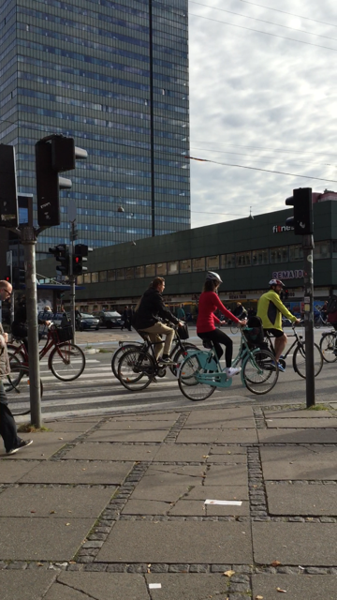
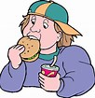

Slide 6
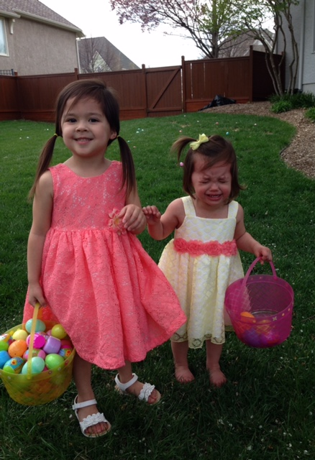

Slide 7
Sensory modulation disorder is one of the categories of SPD
Three subtypes:
Sensory over responsivity
Sensory under responsivity
Sensory craving/seeking

Slide 8
Signs and symptoms of over-responsivity
Dislike textures such as found in fabrics or foods
Avoid crowds and noisy places
Motion sickness not related to other medical explanation
Refuse normal skin contact such as kissing, hugging or cuddling
Feel seriously discomforted by normal sounds, light, movement, smells
Picky eaters
Sleep disorder- waking to minor sounds or problem falling asleep because of sensory overload
Difficulty to self calm

Slide 9
S&S from Under responsivity
Show difficulty waking up
Appear unreactive or slow
Be unaware of pain or other people
Might appear deaf even when auditory functions have been tested
Child might be difficult to toilet train- they are unaware of being wet or soiled

Slide 10
S&S of sensory craving
Fidgets excessively
Seek or make loud disturbing noises
Climb, jump or crash constantly
Suck on or bite clothing, fingers or pencils
Appear impulsive

Slide 11
What is Autism?
It is a bio- neurological development disability that generally appears before the age of 3
Autism impacts the normal development of the brain in the areas of social interaction, communication and cognitive functions
Individuals with autism suffer from numerous co-morbid medical conditions which may include allergies, sleeping disorder, asthma, digestive disorder, feeding disorders, sensory integration dysfunction

Slide 12
Autism Fact and Stats
Affects 1 in 68 children
Boys are 4 times more likely to have autism than girls
40%of children with autism do not speak, 25-30% have words at 12-18 months then lose them. Others may speak but not until late childhood.
No two people with autism are alike

Slide 13
More facts
Austism is diagnosed four times more often in boys than girls. Its prevalence is not affected by race, religion or socio economic status

Slide 14
RACE CAR DRIVER Jamie mcMURRAY TALKS ABOUT aUTISM

Slide 15
Currently there is no cure for Autism but with early intervention and treatment of the diverse symptoms related to autism, greatly improves and in some cases completely overcome.

Slide 16
Autism itself does not affect life expectancy, however research has shown that mortality risk among individuals with autism is twice as high than the general population in large part due to drowning or other accidents

Slide 17
Rate of autism has steadily increased in the past 20 years
Is it because it was not diagnosed properly?
Are we just more aware of the spectrum disorder?

Slide 18
this is a graph up to 2009, in 2014 the prevalence is 1 In 68

Slide 19
Strategies to help Optimize how to care for pts with SPD/Autism

Slide 20
Strategies
At CMH we ask parents to complete a questionnaire to better able to deal with their child with SPD with or without dx of Autism, Aspergers, Downs syndrome, brain injury and communication delays

Slide 21
In the healthcare setting children who are extra sensitive to sensory information may have difficulty with some of their medical care
Becoming upset in busy waiting rooms or as in a mall
Crying when having blood pressure taken
Hiding from the staff and refusing to interact
Becoming unreasonably upset when asked to start a new activity
Covering their ears when new people are talking
Hiding their eyes when new people talk or with bright lights

Slide 23
Calming Sensory Strategies
Proprioceptive input: any input which pushes or pulls on the body’s joints or deep pressure to the body muscles
Tactile Input: How things touch your body
Visual Input: what your child sees
Auditory input: what your child hears
Oral input: what your child eats or puts in his mouth
Vestibular input: how you child moves relative to the ground

Slide 24
Examples of proprioceptive Input:
Bear hugs/comfort holds
Playing/positioning on his tummy so he has to push up with his arms – use Ipads or book while waiting, it also diminishes visual input in a busy room
Swaddling/wrapping in a blanket
Weighted lap pads –either on their lap or if in supine or prone position place over torso
Use vibration toys – spinner toys that vibrate, mini massagers
Arm hugs/squeezes

Slide 25
Examples of tactile input
Firm touch is more calming than light touch or tickles
Stroking child’s back rhythmically from top to bottom
Gently squeeze your child’s hand or feet while you count
Warm blankets or towels- of course not recommended if pt is febrile

Slide 26
Examples of visual input
Watching patterns is often calming to children
iPad games such as Thicket or Neon mania
Spinner toys
Limiting visual input such as turning down the lightsor closing the blinds
Decrease eye contact or approaching child from the side

Slide 27
Examples of auditory input
Slow rhythmic music is calming
Listening to lower tones rather than higher tones
Limiting unexpected loud sounds
Talking in slow low tones
Have a familiar person be the primary speaker rather than many voices
Use headphones to reduce auditory input
Closing the door to the room
Room assignment or in the PACU put is a more isolated area

Slide 28
Examples of oral and vestibular input
Chewy toys, they can chew their shirts, hands or even an IV tubing
Chewing gum is calming
Sucking objects like pacifiers or a straw
For vestibular: moving in one direction such as swinging back and forth or jumping up and down or rocking

Slide 29
Story Telling
Charlie’s Story
JJ’s Story
Ripped from the headlines

Slide 30
In conclusion
Body poll:
How many have taken care of pts with some sensory processing issues?
How many know of someone with a child who has some SPD?
How many have a relative – child, brother, sister, cousin who has SPD?

Slide 31
Thank you!!!
QUESTIONS?

Slide 32
My Madison

